Slide 1
Credible Decentralized Exchange Design via Verifiable Sequencing Rules
Matheus V. X. Ferreira, David C. Parkes
Thalesians Seminar, New York City
October 3rd, 2023

Slide 2
Centralized custody of digital assets

Slide 3
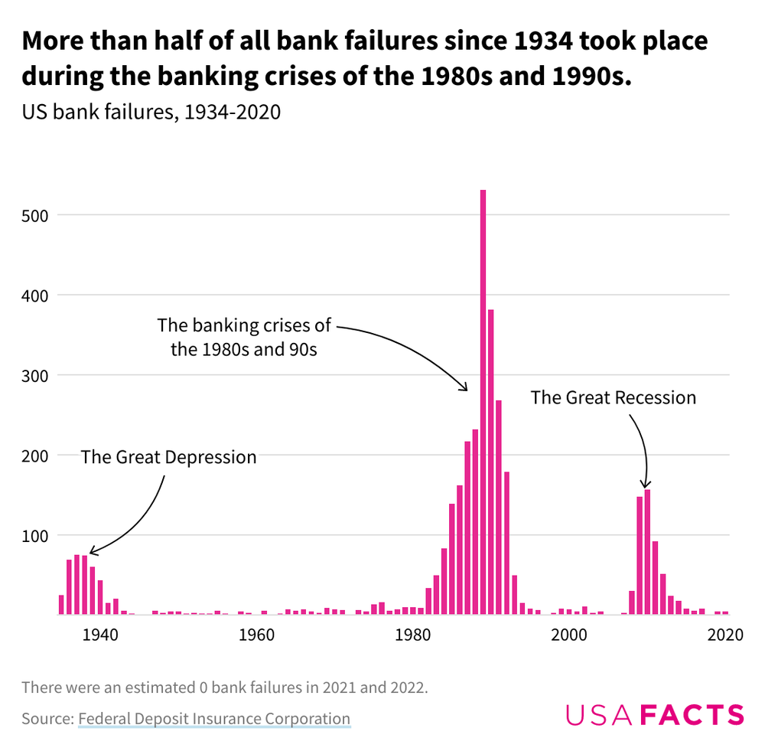

Slide 4
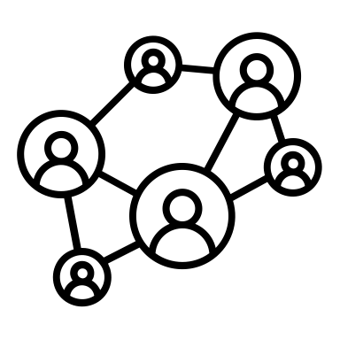
Decentralized custody of digital assets
Blockchain Network

Slide 5
Trading digital assets
Centralized Exchange (e.g., Binance)
Decentralized Exchange (e.g., Uniswap)
US $15B/day
US $1B/day
Trader
Wallet
Blockchain
Exchange
Wallet
Trader
Wallet
Blockchain
Contract (AMM)
Drawbacks:
Low transparency (FTX!!)
Drawbacks:
Market manipulation provides MEV (Maximal Extractable Value)
Notes:
c.f., Nasdaq ~$90B day, NYSE ~$50B/day; IEX ~ $15B/day Sometimes also called maximal extractable value
Stable Pairs, or a price quotation between two cryptocurrencies where the price is designed to be pegged to an external reference such as USD (in the case of USDC) or BTC (in the case of WBTC)
Uniswap ~ US $1B / day Binance 15 billion / day https://coinmarketcap.com/exchanges/binance/ “world’s largest crypto exchange by trading volume, with $76 billion daily trading volume on Binance exchange as of August 2022” Coinbase $1.2 B/day (NYSE/Nasdaq $250B day) Uniswap Labs said it is valued at $1.66 billion in the new funding. The decentralized exchange commands 64% of all DEX volumes, https://techcrunch.com/2022/10/13/uniswap-labs-raises-165-million-in-new-funding/?guccounter=1&guce_referrer=aHR0cHM6Ly93d3cuZ29vZ2xlLmNvbS8&guce_referrer_sig=AQAAAHsRn2vWEoQSR0FldyxP_K4WnIw5w_mfYi8EQn8-DiaEO4d4Ndhh8yhPn_jtM2-D4CQRwGldX4Tm5mwZ9PzyucetXMGef-1kWR1jLpENjqIvMCwqxiCKWvtauF8hmv_I23WKYMTC-0SBf8J2uUB9yO28h9rNNEZMm-a0v5kUSY-b Flashbots Seeks to Raise $50M at $1B Valuation Uniswap Labs said it is valued at $1.66 billion in the new funding. The decentralized exchange commands 64% of all DEX volumes, https://techcrunch.com/2022/10/13/uniswap-labs-raises-165-million-in-new-funding https://cryptobriefing.com/flashbots-seeks-to-raise-50m-at-1b-valuation-report/

Slide 6
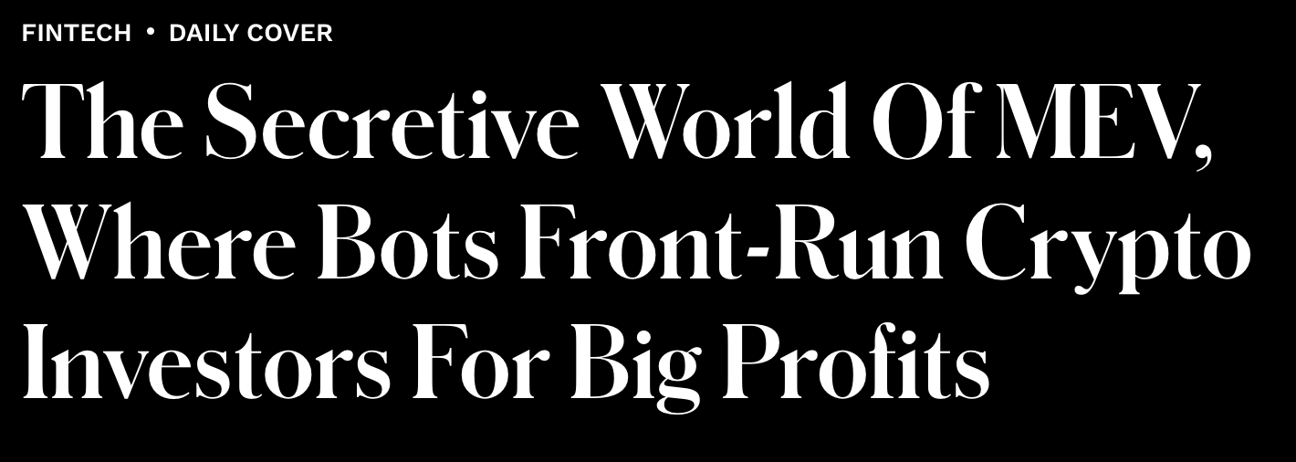
Miner Extractable Value (MEV): miner profits by adding, removing, reordering transactions inside a block.
LEVON BISS FOR FORBES
Oct 11, 2022,06:30am EDT
Notes:
Refer to costumers as traders

Slide 7
Decentralized Exchange
Traders send transactions to a block builder (or miner).
Builder picks an execution ordering on the transactions in a block, this determining the trading prices via a smart contract.
$$S_{1}$$
Sequencer
$$S_{1}, { B}_{2}, { S}_{3}$$
$$Proposer$$
Blockchain
Contract (AMM)
$$B_{2}$$
$$S_{3}$$
``block builder’’
Execution Ordering
(e.g., Uniswap)
Transactions

Slide 8
AMM: Constant Product Market Maker
Locked liquidity $X_{i}$ units of token $i∈\left\{1, 2\right\}.$ Exchange state $\left(X_{1},X_{2}\right)$
Anyone can purchase q units of token 1, pay p units of token 2, where
Next state $(X_{1}−q, X_{2}+p)∈L_{c}(φ)$.
$$φ\left(X\right)=X_{1}∙X_{2}=\left(X_{1}−q\right)∙\left(X_{2}+p\right)$$
$$q$$
$$L_{c}\left(φ\right):level set$$
Token 2 reserves
Cost $p$
$$q$$
Cost $p$
$$X_{1}^{′}$$
$$X_{1}$$
Token 1 reserves

Slide 9
Challenge: Maximal Extractable Value
Daian et al., IEEE IP, 2020
A sequencer can manipulate market clearing by adding and reordering transactions in a block. For example, a sandwich attack:
$$S_{1}$$
$$S_{1}, B_{2}, S_{3}$$
$$Proposer$$
Blockchain
Contract (AMM)
$$B_{2}$$
Sequencer
$$S_{1}, B_{4},B_{2},S_{5},S_{3}$$
``block builder’’
Execution Ordering
$$S_{3}$$
(e.g., Uniswap)
add B₄ and S₅
User
Transactions
MEV = a block where the builder’s final position is weakly better in both tokens, and strictly better in at least one

Slide 10
Challenge
User
$B_{2}$: Buy(q)
Builder
Buy token 1
$$X_{1}−2q$$
$$X_{1}−q$$
$$X_{1}$$
Token 1 reserves
Sell token 1

Slide 11
Challenge
User
$B_{2}$: Buy(q)
Buy(q)
Builder
Buy token 1
$$X_{1}−2q$$
$$X_{1}−q$$
$$X_{1}$$
Token 1 reserves
Sell token 1
Sell(q)

Slide 12
Cost manipulation on Uniswap (Lower bound)
Million USD
MEV (PoW)
MEV (PoS)
~$1M/day (on ~1B/day volume); i.e., around ~0.1%
Adapted from https://explore.flashbots.net
Notes:
Around $1M/day ; and so about 0.1% of volume Auction bids reflect around 1/3 of value of MEV , only 3-4 relays bidding
Flashbots Seeks to Raise $50M at $1B Valuation: Report Public MEV was the MEV they counted before PoS (https://transparency.flashbots.net/) and Auction MEV is the revenue from the PoS auction Maybe we should just call PoW vs PoS MEV
The PoW MEV they used heuristics. They discuss a bit the methodology here: https://explore.flashbots.net/data-metrics about 20K eth a month, so around 30M USD a month

Slide 13
How do we know? Flashbots Auction
Sequencer
…
$$T_{1}$$
$$Blockchain$$ $contract$ (AMM)
$$T_{2}$$
Sequencer
$$Auction$$
$$T_{1}, T5,T_{2},T4, T_{3}$$
$$Proposer$$
$$T_{3}$$
(MEV-Boost)
…
Execution Ordering
$$T$$
Sequencer
Goal: “Making MEV more democratic”
Flashbots raised $60M at $1B Valuation (CoinDesk, July 2023)
More than 90% of Ethereum blocks are created through the Flashbots auction
Notes:
Since PoS, bound together by “Proposer Builder Separation (PBS)” framework
(Jan 2021+) Private pools
Mitigating this concern is that the Ethereum foundation plans to move to a Proposer Builder Separation (PBS) framework [4] in 2023-24 https://techcrunch.com/2022/10/13/uniswap-labs-raises-165-million-in-new-funding https://cryptobriefing.com/flashbots-seeks-to-raise-50m-at-1b-valuation-report/

Slide 14
What can be done about this?

Slide 15
Possible Solutions to MEV
Name | Properties | Limitations
Batch auctions (CoW Swap) | Uniform pricing [Budish et al, 2015] | Cost. Computing clearing prices Latency. Transactions are only executed once the clearing price is confirmed Liquidity. Requires a new smart contract
Encrypted Mempool (Chainlink, Offchain Labs, etc.) | Transactions are encrypted before executing (hide information); FCFS | Decryption. Requires a trusted committee (e.g., threshold encryption) Inefficient. Transaction conflicts
Trusted sequencer (Flashbots Protect, bloXroute) | Computationally efficient | Low Transparency (not auditable)

Slide 16
Flashbots Protect (Private Pool)
Private pool
$$T_{1}$$
Flashbots Sequencer
$$T_{2}$$
(Builder)
Bundles
$$Blockchain$$ $contract$ (AMM)
Sequencer
$$Auction$$
$$T5,T_{3},T4, T_{1}{,T}_{2}$$
$$Miner$$
$$T_{3}$$
…
(MEV-Boost)
Execution Ordering
(Proposer)
$$T_{4}$$
Sequencer
$$T$$
Offers frontrunning protection for transactions in private pool.
But needs trust (cannot be validated).
Notes:
Private pools
Mitigating this concern is that the Ethereum foundation plans to move to a Proposer Builder Separation (PBS) framework [4] in 2023-24

Slide 17
Our solution

Slide 18
Credible Decentralized Exchange
Main result. For any transaction that is executed, if some party gains, then the execution price is better than the standalone price.
$$S_{1}$$
$$B_{2}$$
$$Blockchain$$ $contract$ (AMM)
Sequencer
$$S_{1}, B_{4},B_{2},S_{5},S_{3}$$
$$S_{3}$$
Execution Ordering
$$B_{4}$$
verifiable sequencing rule

Slide 19
Backdrop: Credible Auctions

Slide 20
Sealed Bid Second-Price Auctions [Vickrey ‘61]
Alice
Auction
Bob
Bid $80
Bid $20
Pay $20
$79
Auctioneer receives bids privately.
Highest bidder wins, pays second highest bid. All other bidders pay nothing.
Not credible. Can charge $79
Credible: auctioneer does not have a useful undetectable deviation.
Notes:
Because of this limitation of first-price auctions in online advertising, the internet popularized second-price auctions.

Slide 21
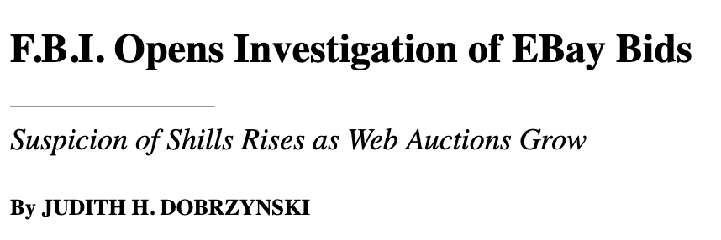
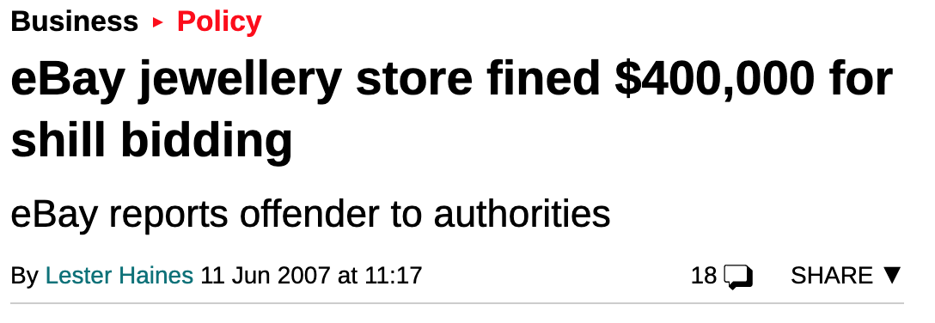
Sellers can be a powerful adversary
June 7, 2000

Slide 22
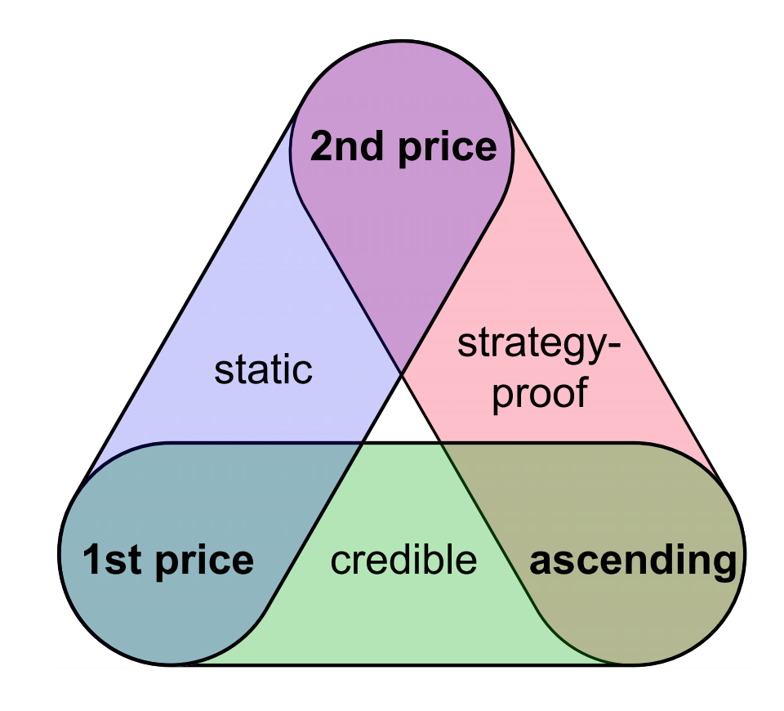
A Credible Auction Trilemma
[Akbarpour and Li ‘20]
1st, 2nd price, and ascending auctions are all uniquely specified amongst optimal auctions
Cryptography can circumvent the trilemma [Ferreira, Weinberg ‘20], [Essaidi, Ferreira, Weinberg ‘21], [Chitra, Ferreira, Kulkarni ‘23]

Slide 23
Can we construct a DeX that is credible?
We propose a verifiable sequencing rule that ensures that for any transaction A included in the block,
Cheating by sequencer is observed, or
The execution price of A is as good as if A was the only order to execute, or
The execution price of A is worse than this “standalone price” and no party gains by including A.

Slide 24
What is our Verifiable Sequencing Rule?

Slide 25
Formal Model
Each transaction is $Buy(q, r)$ or $Sell\left(q, r\right):$
$Buy(q, r)$: buy $q$ units of token 1, but successfully execute only if the user pays at most reserve $r$ in token 2
$Sell\left(q, r\right)$: sells $q$ units of token 1, but successfully execute only if the user receives at least reserve $r$ in token 2
A sequencer can add or censor transactions in any way, and picks an execution ordering $\left(T_{1},…, T_{n}\right)$ on included transactions
For this talk, assume a constant product market maker (more general in the paper).

Slide 26
Verifiable Sequencing Rules
For state $X$ and set of included transactions $T_{1},…, T_{n}$, a sequencing rule $S$ defines a non-empty collection $S(X, \left\{T_{1},…, T_{n}\right\})$ of orderings
Efficient: there is a poly-time algorithm to output a valid execution ordering, some $\left(T_{1},…, T_{n}\right)∈S\left(X, \left\{T_{1},…, T_{n}\right\}\right)$
Verifiable: there is a poly-time algorithm that takes $(X, T)$ and outputs True if and only if $\left(T_{1},…, T_{n}\right)∈S(X, \left\{T_{1},…, T_{n}\right\})$

Slide 27
A stronger security definition
Definition. A sequencing rule S is MEV-proof if there is no state $X,$ no set of transactions $\left\{T_{1},…,T_{n}\right\}$, and no execution ordering, $T∈S(X, \{T_{1},…,T_{n}\})$, where the sequencer obtains risk-free profits by executing $T$.

Slide 28
Impossibility Result
Theorem. No sequencing rule is MEV-proof for the CPMM.
Proof sketch:
Suppose T is {3 @ Buy(2), 3 @ Sell(1)}. Show whatever the ordering, there exists an MEV attack
Example:
Buy token 1
Sell token 1
$$T_{3}$$
$$T_{2}$$
$T_{1}$: Buy(2)
$$X_{1}−6$$
$$X_{1}−5$$
$$X_{1}−4$$
$$X_{1}−3$$
$$X_{1}−2$$
$$X_{1}$$
Token 1 reserves
$T_{4}$: Sell(1)
$$T_{5}$$
$$T_{6}$$

Slide 29
Impossibility Result
Theorem. No sequencing rule is MEV-proof for the CPMM.
User
Proof sketch:
Suppose T is {3 @ Buy(2), 3 @ Sell(1)}. Show whatever the ordering, there exists an MEV attack
Example:
Sequencer
Buy token 1
Sell token 1
$$T_{3}$$
$$T_{2}$$
$T_{1}$: Buy(2)
$$X_{1}−6$$
$$X_{1}−5$$
$$X_{1}−4$$
$$X_{1}−3$$
$$X_{1}−2$$
$$X_{1}$$
Token 1 reserves
$T_{4}$: Sell(1)
$$T_{5}$$
$$T_{6}$$
Show that, for any order, at least two sells must trade at a higher price than the lowest-priced buy.

Slide 30
The Verifiable Sequencing Rule
Input: initial state $X_{0}=\left(X_{0, 1}, X_{0, 2}\right)$, transactions${ (Q}^{buy},Q^{sell})$ yet to include
Output: execution ordering $T$(initially empty, length t)
While $Q^{buy}$ and $Q^{sell}$ are both non-empty:
If $X_{t,1}≥X_{0,1},$ append any $A$ $∈Q^{buy}$ to T and remove $A$ from $Q^{buy}$.
Else, append any $A$ $∈Q^{sell}$ to $T$ and remove $A$ from $Q^{sell}$.
Append the remaining transactions to $T$ in any order
$$B_{4}$$
$$B_{6}$$
$$B_{1}$$
$$X_{1}−3$$
$$X_{1}−2$$
$$X_{1}−1$$
$$X_{1}$$
Token 1 reserves
$$S_{2}$$
$$S_{3}$$
Transactions Q={B,B,B,S,S,S}
$$S_{5}$$

Slide 31
Example: Verifiable Sequencing Rule
$T_{2}$: Buy(q)
$T_{1}$: Buy(q)
Not allowed. The sell transaction has to be sequenced after the first buy.
$$X_{1}−2q$$
$$X_{1}−q$$
$$X_{1}$$
Token 1 reserves
User
$T_{3}$: Sell(q)
Legal sequences:
Buy(q), Sell(q), Buy(q) Buy(q), Sell(q), Buy(q) Sell(q), Buy(q), Buy(q) Sell(q), Buy(q), Buy(q)
Sequencer
With Verifiable Sequencing Rule
Buy token 1
$T_{1}$: Buy(q)
Sell token 1
$T_{3}$: Buy(q)
$$X_{1}−q$$
$$X_{1}$$
Token 1 reserves
$T_{2}$: Sell(q)

Slide 32
Main Theorem
Theorem. For any included user transaction A, either the price for A is better than isolated execution of A, or the sequencer does not gain by including A.
Proof sketch.
T₁, T₂, T₃, …, T_{k}, T_{k+1}, ..., T_{n}
Core (not last buy, or last sell)
Tail (all buys, or all sells)
Price is better than isolated execution
No user transaction is followed by a sequencer’s transaction (and so, no gain).
Also: the sequencing rule is computationally efficient.
Why? Suppose Tail is Buy orders, with
Buy, Buy, Buy. Sequencer prefers Buy, Buy, Buy.
Notes:
Core Tail

Slide 33
As per Impossibility, not Fully MEV-Proof
User
Sequencer
User: Buy(q=2), Buy(q=2), Sell(q=1)
Sequencer: Buy(q=2), Sell(q=1), Sell(q=1)
Buy token 1
Sell token 1
$$B_{4}$$
$$B_{6}$$
$$B_{1}$$
$$X_{1}−3$$
$$X_{1}−2$$
$$X_{1}−1$$
$$X_{1}$$
Token 1 reserves
$$S_{2}$$
$$S_{3}$$
$$S_{5}$$

Slide 34
Conclusion
We give an impossibility result: for any deterministic sequencing rule, there is an instance where the sequencer extracts risk-free profits.
We provide execution price guarantees for users.
Block builders could “bet their reputation” on using a sequencer that satisfies our rule.
Open questions:
Can we design good sequencing rules for trades on $m≥3$ tokens, e.g., $φ\left(X_{1}, X_{2},X_{3}\right)=X_{1}{∙X}_{2}∙X_{3}$?
Can we derive bounds on execution quality, i.e., a price of anarchy (relative to best possible execution quality)?
Understanding credibility in other markets (order books, matching, …)
Matheus V. X. Ferreira and David C. Parkes, Credible Decentralized Exchange Design via Verifiable Sequencing Rules, STOC’23
https://arxiv.org/abs/2209.15569

Slide 35
Questions?
``… people have realized that security failure is caused at least as often by bad incentives as by bad design.’’ [Anderson and Moore, 07]
Adversary
Algorithm

